Slide 1

COMP-SCI 5565-0002 Introduction to Statistical Learning
Lecture 1 - Introduction
Tianhang Zheng
University of Missouri-Kansas City
Division of Computing, Analytics, and Mathematics
School of Science and Engineering

Slide 2
Course Website

Slide 3

Junk Mail Filtering
Given some examples of what the user defined as junk mail.
From these examples, learn to identify new incoming junk mail.

Slide 4
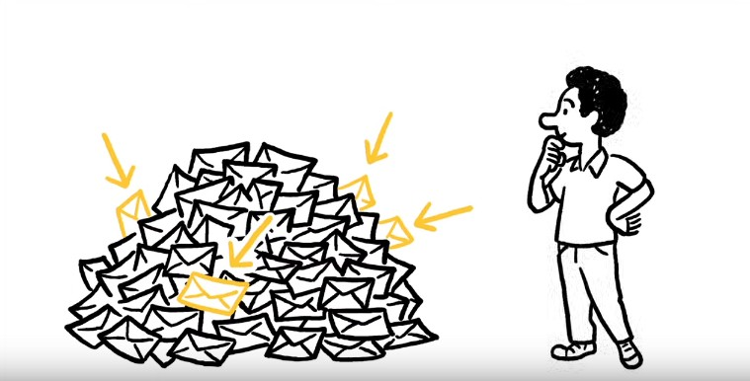
Gmail - Priority inbox
Given examples of what the user defined as important mail. From these examples, learn to identify new important mail.

Slide 5
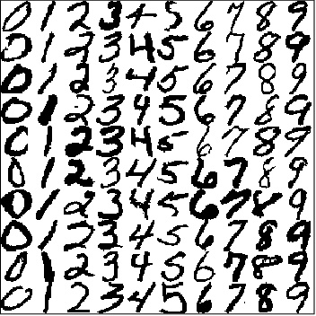
Handwritten Digit Recognition
Given handwritten ZIP codes on letters, money amounts on cheques, etc.
Learn to recognize the correct digit written by hand.

Slide 6
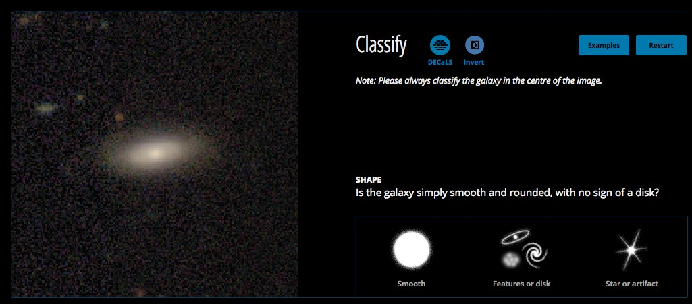
Galaxy classification
Given images of the sky from SDSS and CTIO, and crowdsourced labels
From these examples, learn to identify galaxies.
http://www.galaxyzoo.org/#/classify

Slide 7
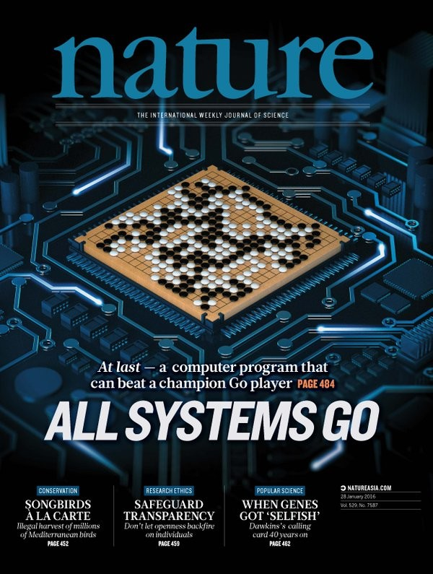
Go
Uses a combination of deep neural networks and tree search.
Beat world champion Lee Sedol in 2016.

Slide 8
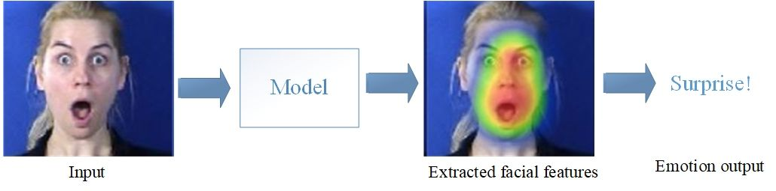
Image Classification
Uses convolutional neural networks to extract image features
Then uses the extracted features to identify unseen images
Baffour et. al., "Facial expression recognition via coarse-grained and fine-grained feature representation"

Slide 9
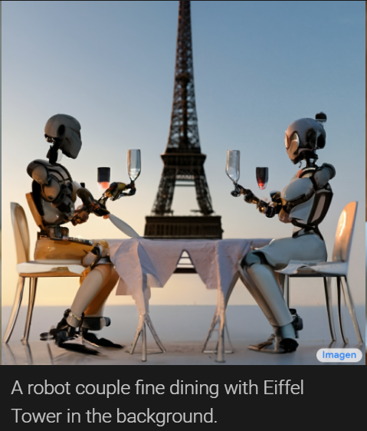
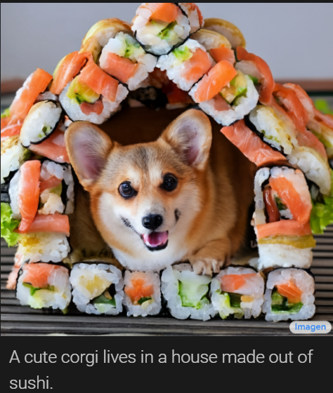
Image Generators
AI system that creates photorealistic images from input text
https://imagen.research.google/

Slide 10
Other applications of Machine Learning
autonomous robotics
bioinformatics
detecting network intrusion
neuroscience
medical diagnosis
stock market analysis
social network analysis
traffic and infrastructure planning
…

Slide 11
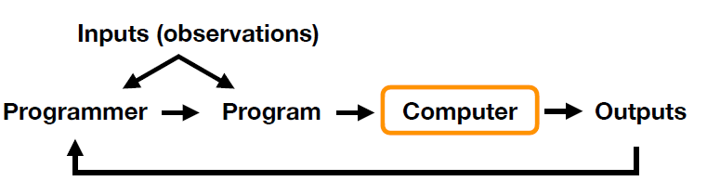
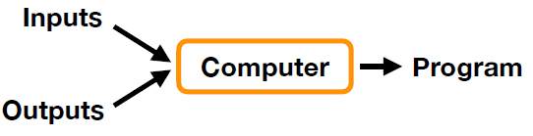
Machine learning vs. “classic” programming.
Traditional programming paradigm
Machine learning paradigm

Slide 12
What is common to these examples?
Given some data (e.g. handwritten digits).
Possibly some extra information (e.g. which digit does this number represent)
Goal: Built a machine that can learn from the given data utilizing the extra information (if available).

Slide 13
Flavor of this course
Formalize intuitions about problems
Use the language of mathematics to express models
Geometry, vectors, and linear algebra for reasoning
Probabilistic models to capture uncertainty
Calculus to identify good parameters
Design and analysis of algorithms
Numerical algorithms in python
Understand the choices when designing machine learning methods

Slide 14
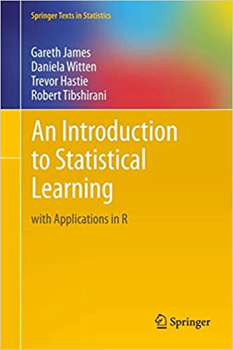
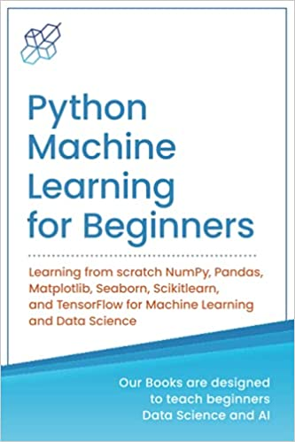
Textbooks

Slide 15
What is Machine Learning?
Definition (First Try)
Machine learning is concerned with designing and developing algorithms that allow machines to learn.
machines? computers? to learn?
need to quantify "learning"
to improve their performance over time
Definition (Second Try)
Machine learning is concerned with the design and development of algorithms that allow computers (machines) to improve their performance over time.

Slide 16
What is Machine Learning?
What is the source of the improved performance?
New insights by the algorithm designer?
Definition (Final version)
Machine learning is concerned with designing and developing algorithms that allow computers (machines) to improve their performance over time based on data.
Definition (Mitchell, 1998)
A computer program is said to learn from experience E with respect to some class of tasks T and performance measure P, if its performance at tasks in T, as measured by P, improves with experience E.

Slide 17
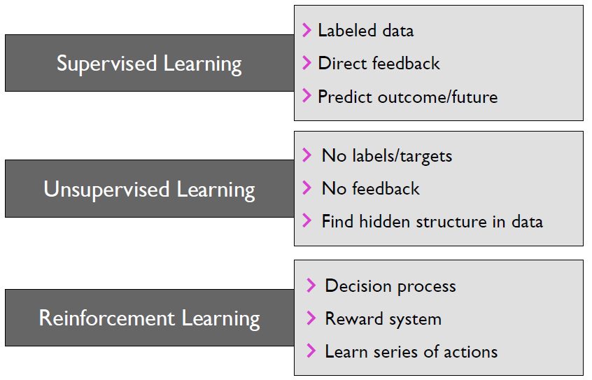
Categories of Machine Learning

Slide 18
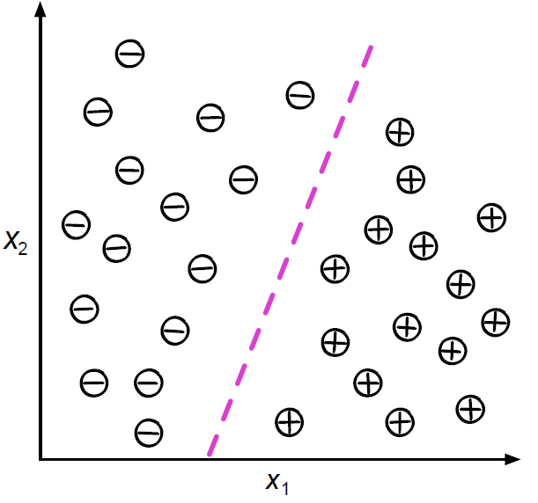
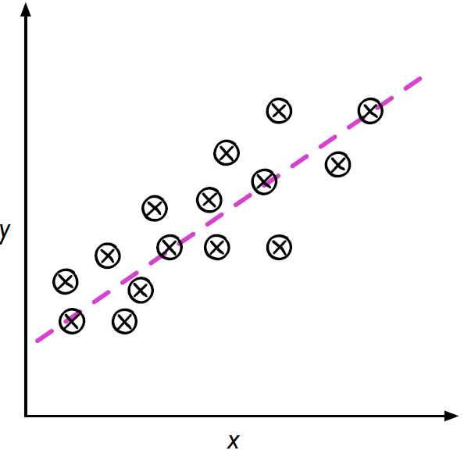
Categories of Machine Learning
Supervised learning
Supervised learning is the subcategory of machine learning that focuses on learning a classification, or regression model, that is, learning from labeled training data.

Slide 19
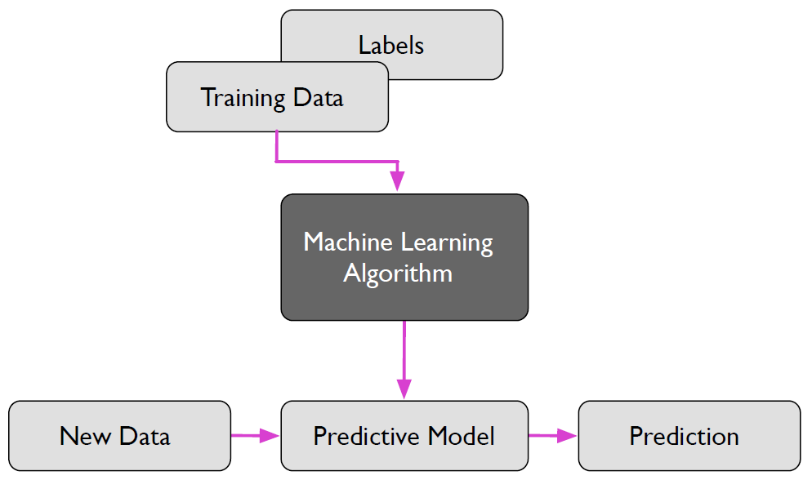
Categories of Machine Learning
Supervised learning
A rough overview of the supervised learning process.

Slide 20
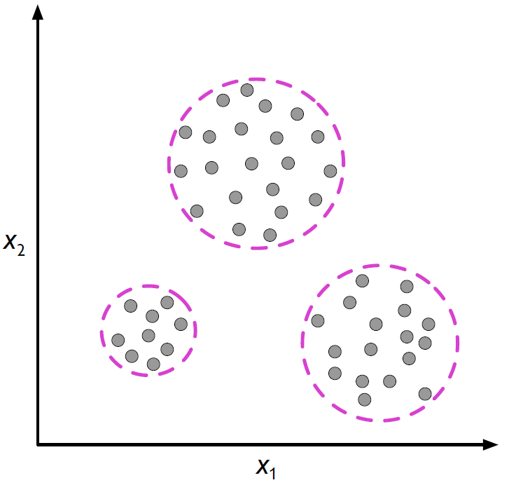
Categories of Machine Learning
Unsupervised learning
Unsupervised learning is a branch of machine learning that is concerned with unlabeled data. Common tasks in unsupervised learning are clustering analysis and dimensionality reduction.

Slide 21
Categories of Machine Learning
Semi-supervised learning
Loosely speaking, semi-supervised learning can be described as a mix of supervised and unsupervised learning.
In semi-supervised learning tasks, some training examples contain outputs, but some do not.
We then use the labeled training subset to label the unlabeled portion of the training set, which we then also utilize for model training.

Slide 22
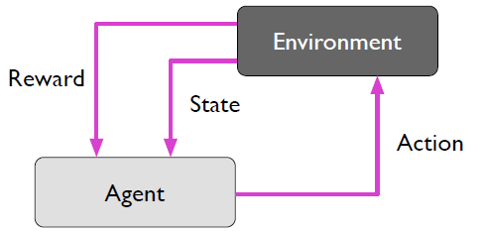
Categories of Machine Learning
Reinforcement learning
Reinforcement learning is the process of learning from rewards while performing a series of actions.
In reinforcement learning, we do not tell the learner or agent (for example, a robot), which action to take but merely assign a reward to each action and/or the overall outcome.
Instead of having “correct/false” labels for each step, the learner must discover or learn behavior that maximizes the reward for a series of actions. In that sense, it is not a supervised setting.
Notes:
Example: Game playing. There is one reward at the end of the game (negative or positive).
Find suitable actions in a given environment with the goal of maximizing some reward.
correct input/output pairs never presented Reward might only come after many actions.
Current action may not only influence the current reward, but future rewards too.

Slide 23


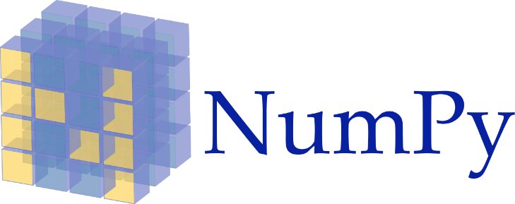



Tools

Slide 24
Python Resources
Kaggle: https://www.kaggle.com/learn/python
Learn Python: https://www.learnpython.org/
Python for Beginners by Microsoft: https://learn.microsoft.com/en-us/shows/intro-to-python-development/
Python for Everybody (up to 6 hours): https://www.youtube.com/watch?v=8DvywoWv6fI
Google it

